Slide 1
Activity Control, Planning and Data Flow Diagrams
Presentation 3
Course: CSE 4408 – System Analysis and Design Lab

Slide 2
Team Composition
Member Name | Member ID
Mohammad Ishrak Abedin | 160041051
Shakleen Ishfar | 160041029
Anika Tasnim Preoty | 160041044

Slide 3
Activity Planning

Slide 4
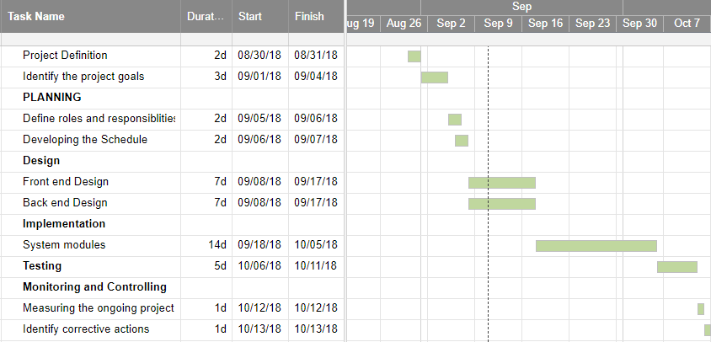
Gantt Chart
A.
B.
C.
D.
E.
F.
G.
H.
I.
J.

Slide 5
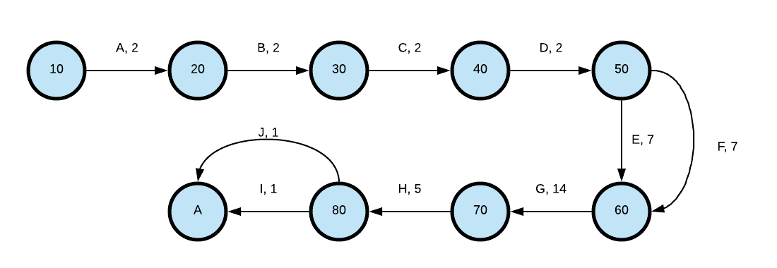
PERT Diagram
90

Slide 6
Data Flow Diagrams

Slide 7
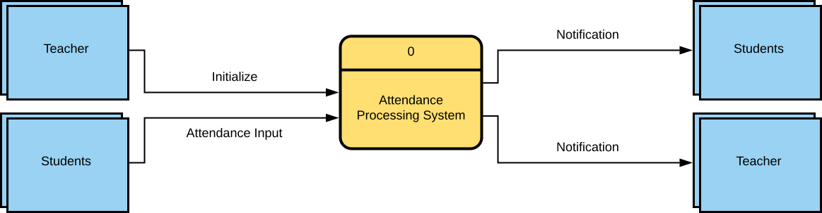
Context Diagram

Slide 8
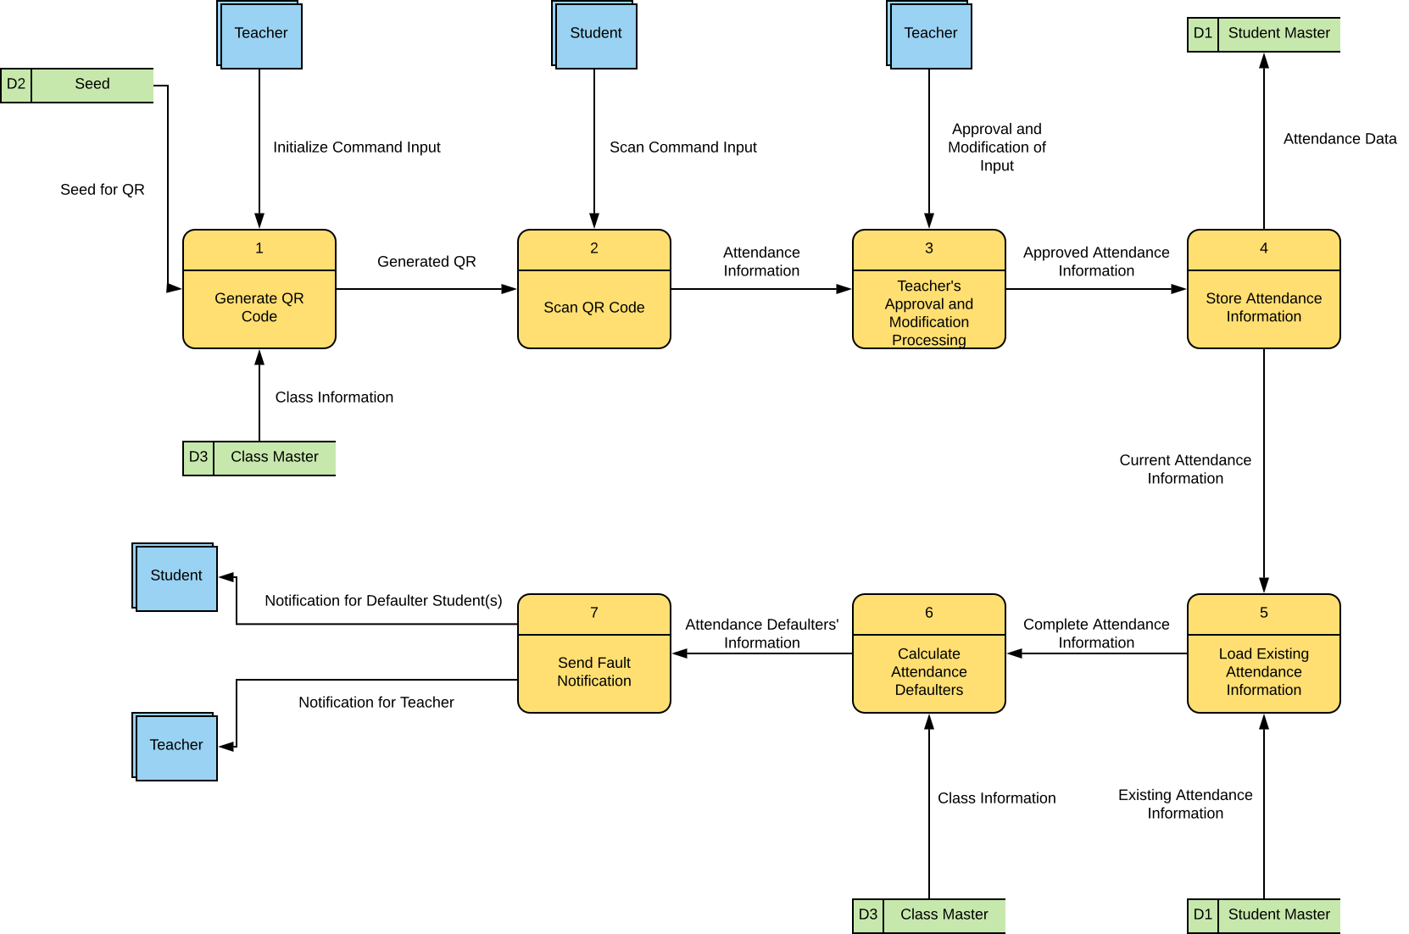
Zero Diagram

Slide 9
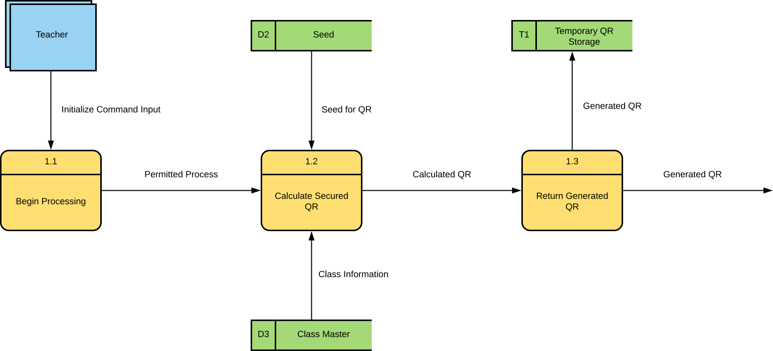
Diagram 1

Slide 10
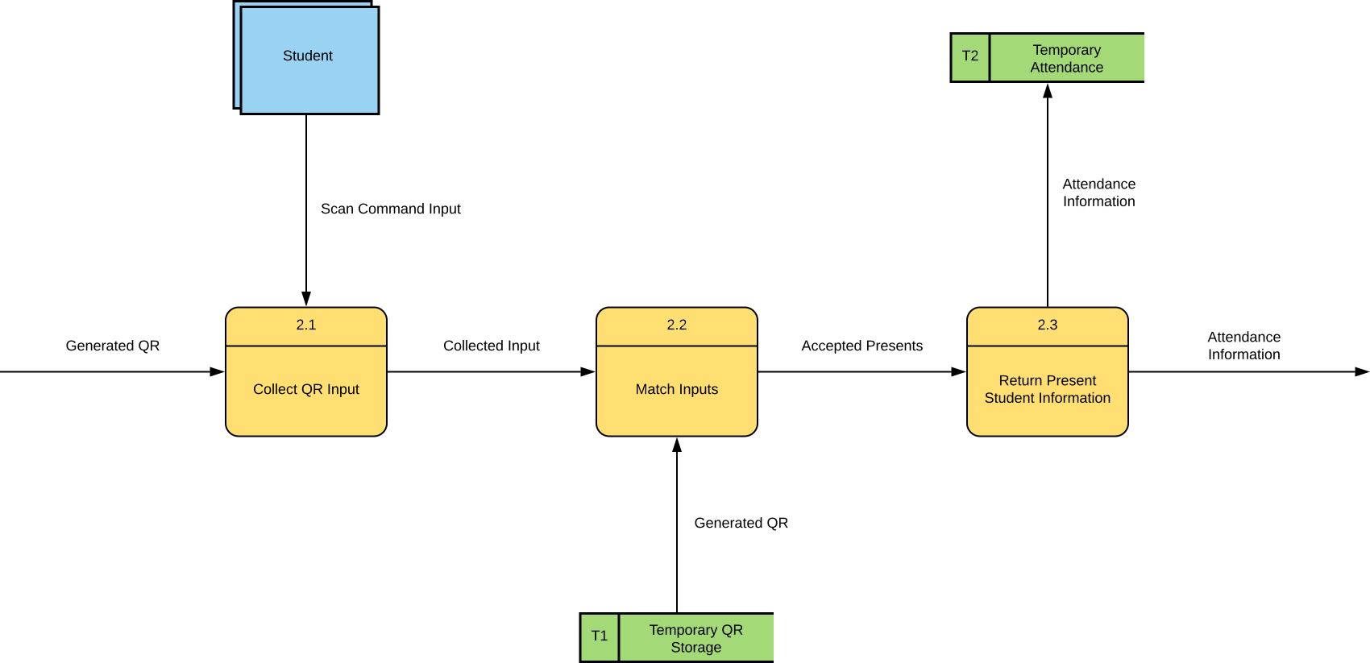
Diagram 2

Slide 11
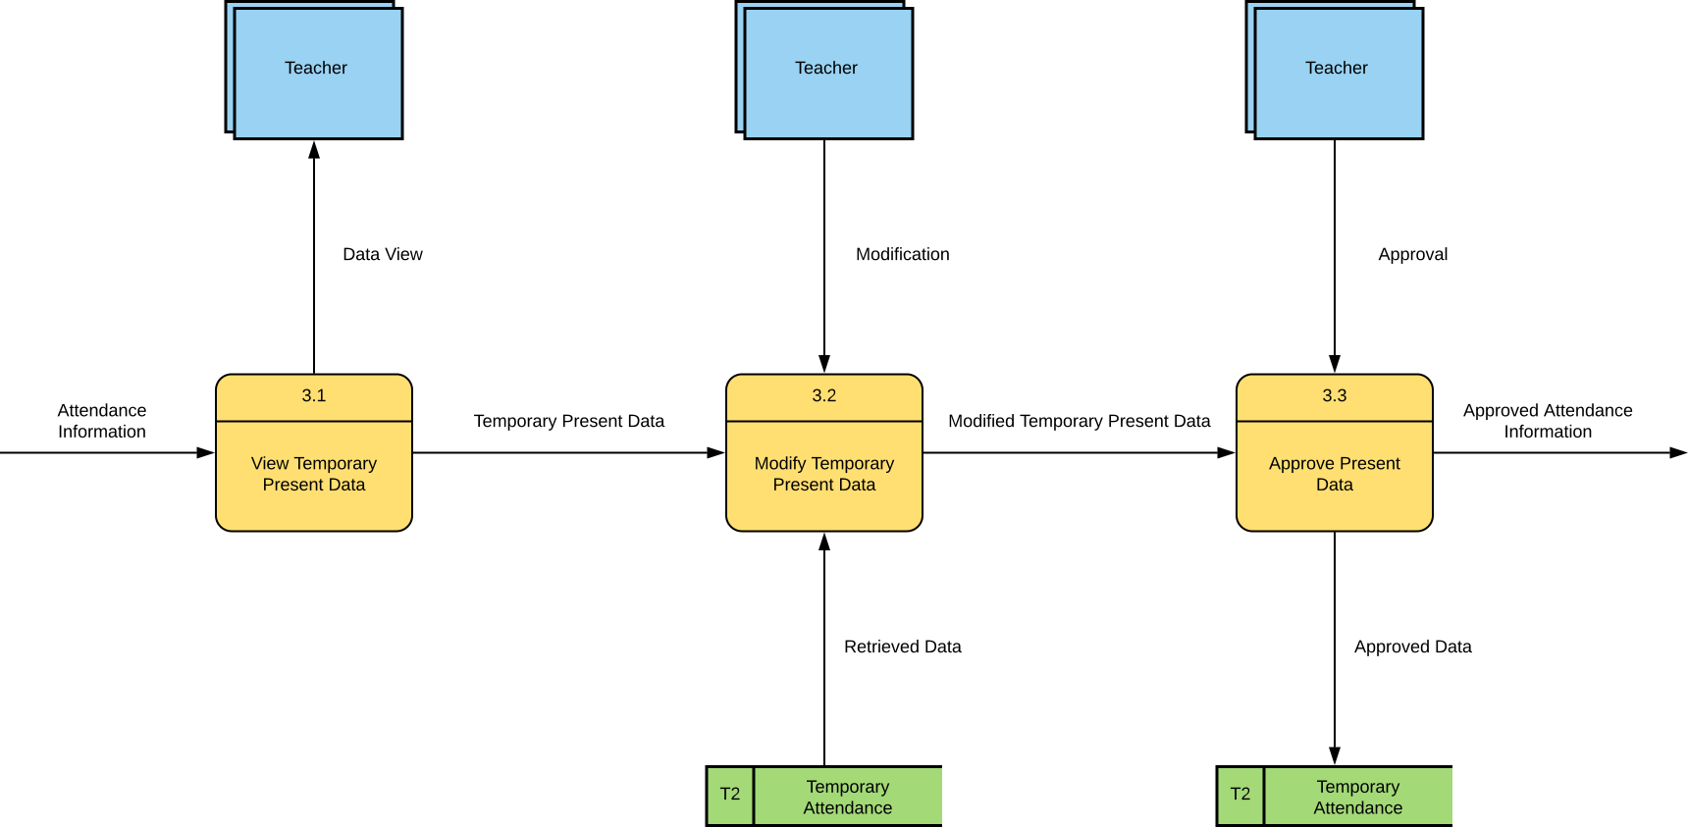
Diagram 3

Slide 12
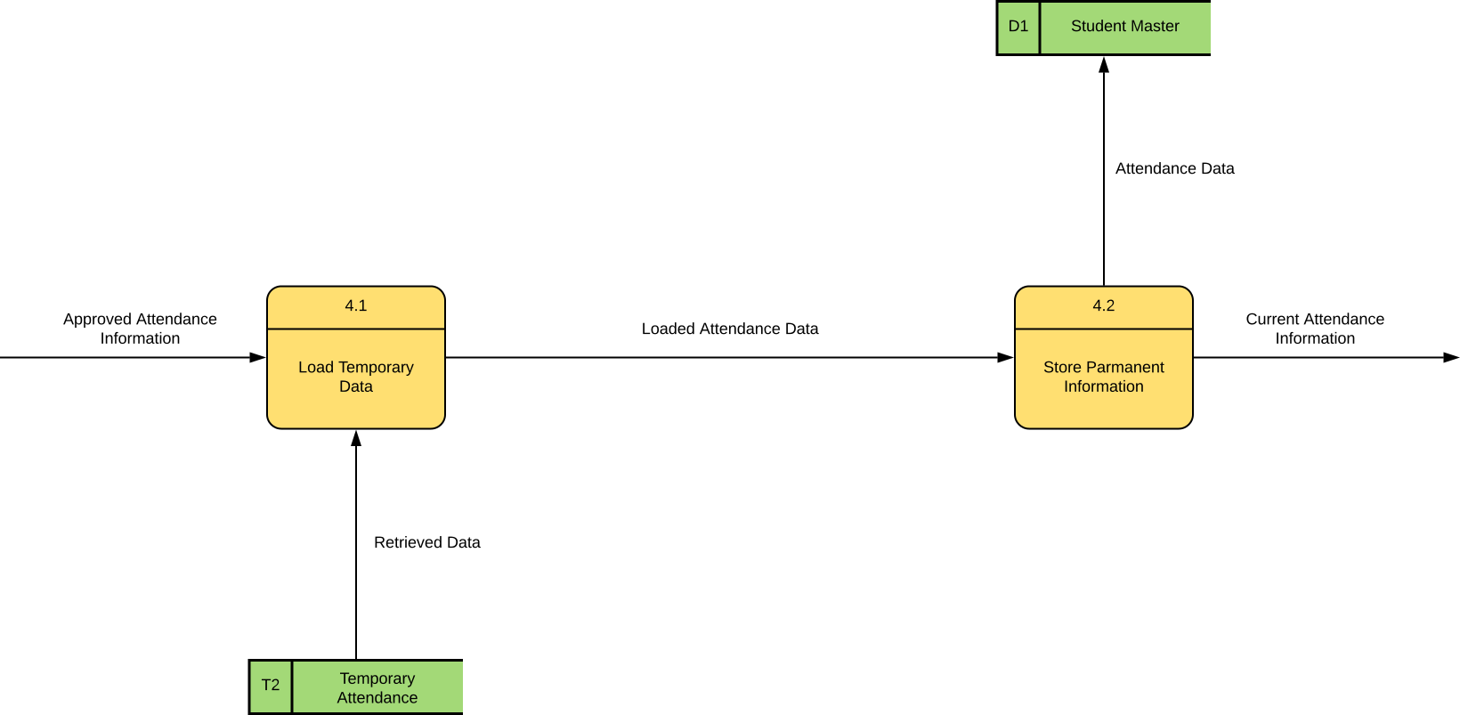
Diagram 4

Slide 13
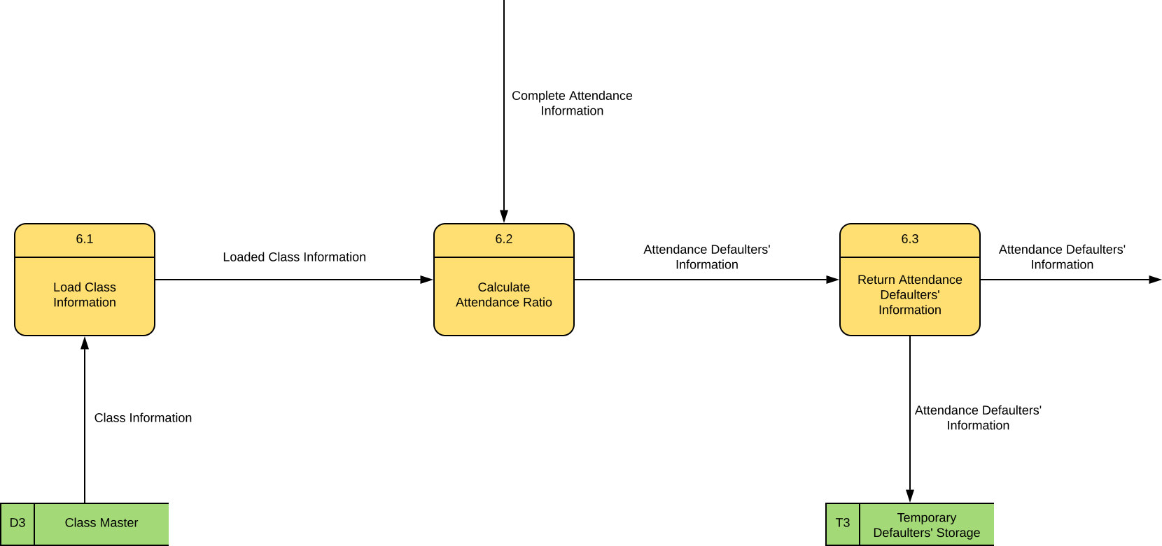
Diagram 6

Slide 14
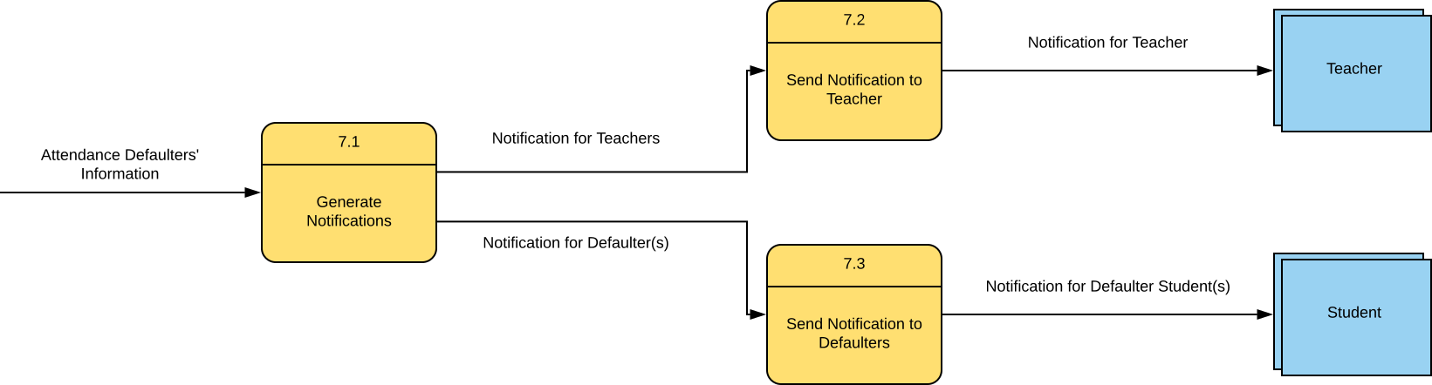
Diagram 7

Slide 15
Thank you!
Any Questions?

